Slide 1
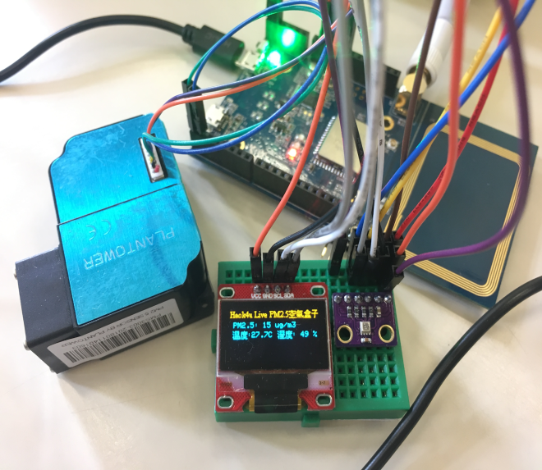
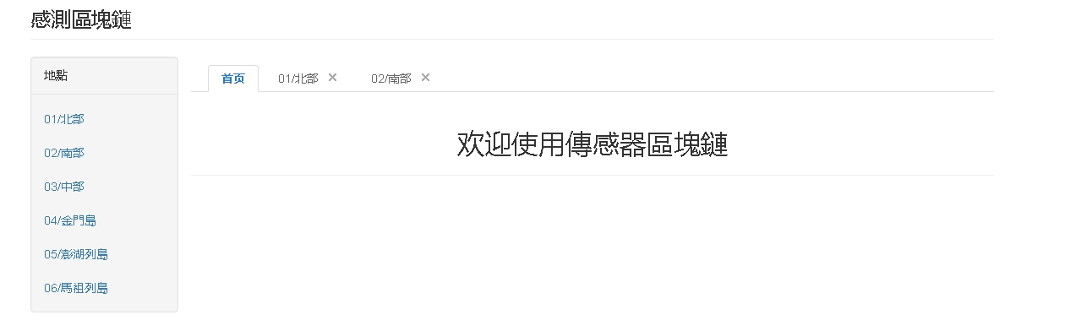
GROUP 10
Agricultural Water Quality Field Testing Blockchain
Member:
胡甯寧 R06922140（組長）
于浩天 T06901303（副組長）
廖政彰 B05902081
黃冠博 B05902121
黃知盈 R06922151
洪駿輝 B05902065

Slide 2
Proposal——Based on Current problems in organic agriculture
Green food has been a common diary term.
Food is the most important part of our lives. Making sure the food safety is also deeply important.
Improving the safety of food may have huge cost. Therefore, the green food is much more likely to be more expensive.
However, consumers can not easily distinguish the real green healthy food from the fake one.
What makes it worse is that some fake green food may mixed with the real one and it makes the consumers confused and damages the interest of real green food.

Slide 3
The original intention of the group project
Combine blockchain information is more difficult to modify
And the timeliness after data networking can help consumers verify the authenticity of organic produce at any time
Cooperate with air boxes to conduct more comprehensive monitoring to prevent farmers from making fakes

Slide 4
Solution
It is very important to detect which one is the green food and which one is not.
As is known to most of us, the water is often a measure factor in our environment quality.
What water is to the environment is like the blood to our body.
Therefore if we can measure the quality of water, we can easily tell which one is the real green food.

Slide 5
Solution
So we can build a block-chain system to solve our problem.
Block-chain is a kind of immutable data structure. It has accurate credit and the data are of great accuracy.
The system will allow everyone to upload data into the block-chain and the data are open to everyone.
By this way, we can build a Water Quality Field Detection Block-chain to measure the water quality to tell which is the real green food.

Slide 6
Main functions
We use block-chain to record the quality distribution of water in order to improve the reliability of data.
The sensor will upload data to block-chain system and the data will not be changed afterward.
The sensors will be distributed to construct the water quality field of specific area.
The sampling data will be stored in the block-chain and it is open to everyone. The system will hold an interface for other nodes to join in.

Slide 7
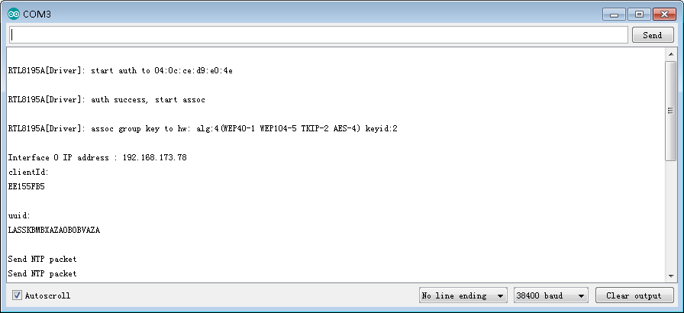
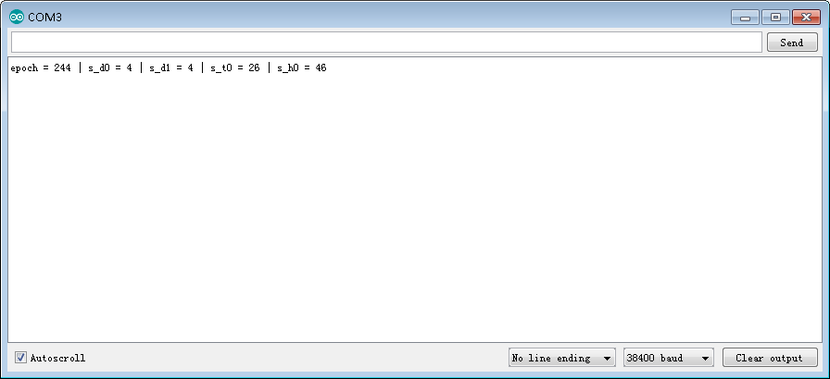
Original digital source is from the OTA block-chain
Every air-box has its own ID.
The record data is like this form above PM T H

Slide 8
Our this week task is to do like this

Slide 9
What we’ve done
We make sensors and
use it to collect field
data automatically
Build your own blockchain

Slide 10
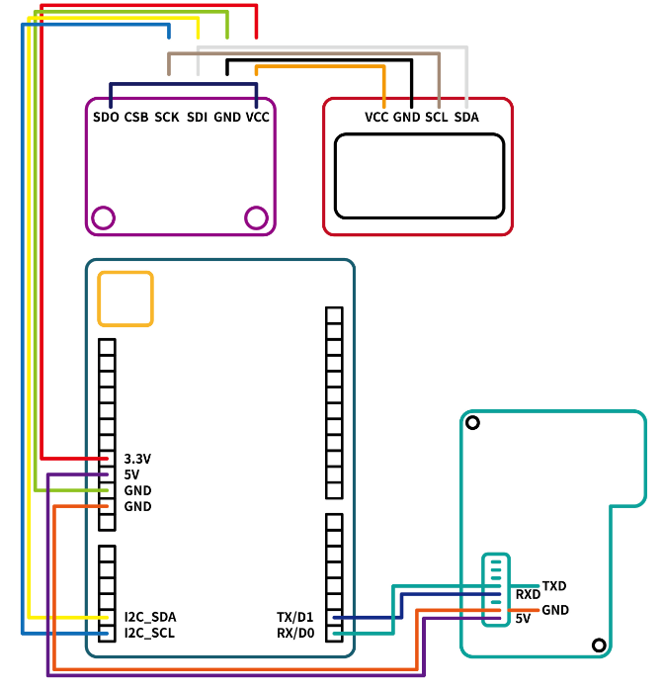
The progress of the sensor and what problem we are met
1. make the electric circuit
1.1 首先將顯示板與氣
壓溫濕度感測器相連：
VCC↔VCC GND↔GND
SCL↔SCL SDA↔SDA
1.2 之後將氣壓感測器
與AMEBA板相連接：
VCC↔3,3v GND↔GND
SDA↔SDA SCL↔SCL
1.3. 之後將PM2.5感測器
與AMEBA板相連接:
VCC↔5V GND↔GND
TXD↔RX/D0 RXD↔TX/D1
Wiring diagram

Slide 11
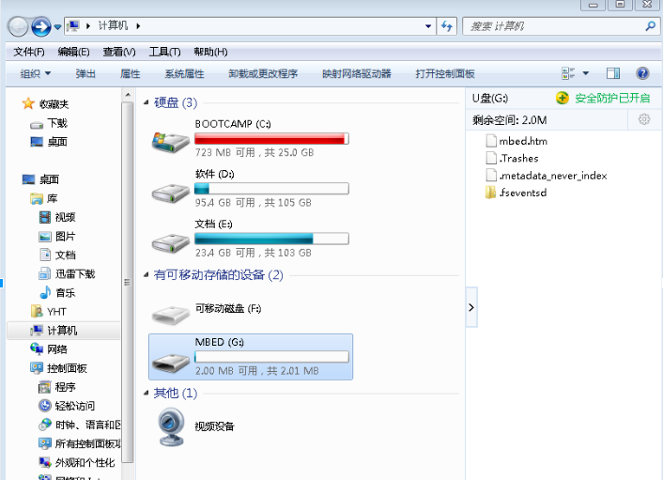
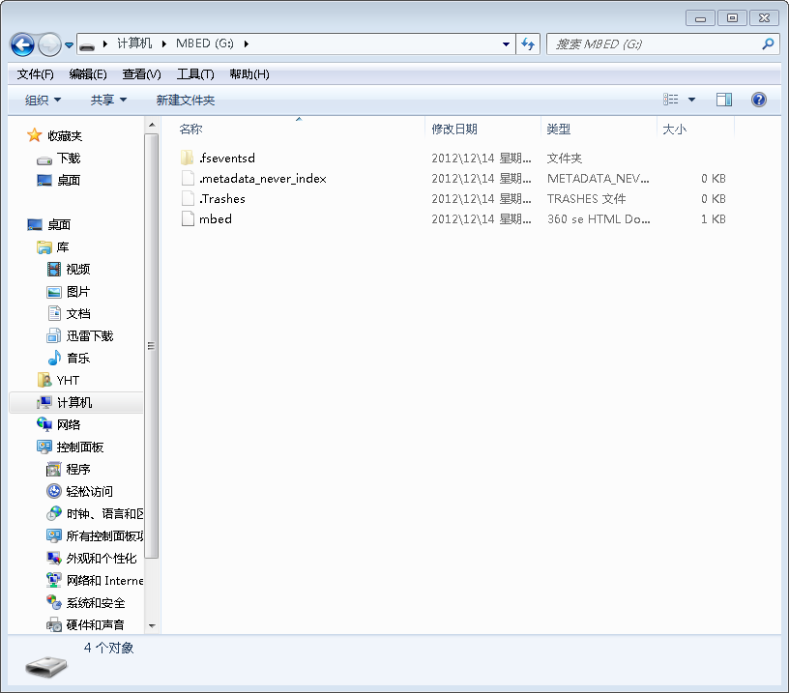
The progress of the sensor and what problem we are met
2. 更新DAP Firmware 安装driver 与arduino
2.1 更新 DAP Firmware

Slide 12
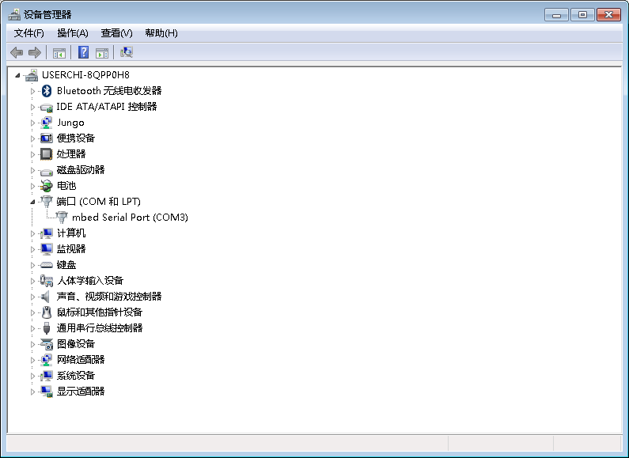
The progress of the sensor and what problem we are met
2. 更新DAP Firmware 安装driver 与arduino
2.1 更新 DAP Firmware
2.2安装driver

Slide 13
The progress of the sensor and what problem we are met
2. 更新DAP Firmware 安装driver 与arduino
2.1 更新 DAP Firmware
2.2 安装driver
2.3 安装arduino
安裝arduino
對arduino進行設置
在 Additional Boards Manager URLs: 填入：
https://github.com/Ameba8195/Arduino/raw/master/release/package_realtek.com_ameba_index.json d. 填完之後按 OK，然後因為改編輯器語言的關係，我們將 Arduino IDE 關掉之後重開 e. 在 Boards Manager 裡，它需要約十幾秒鐘整理所有硬體檔案，如果網路狀況不好可能會等上數分鐘。每當有新的硬體設定，我們需要重開 Boards Manager，所以我們等一會兒之後，關掉 Boards Manager，然後再打開它，將捲軸往下拉找到 Realtek Ameba Boards，點右邊的 Install，這時候 Arduino IDE 就根據 Ameba 的設定檔開始下載 Ameba 所需要的檔案
f. 到 Tools -> Board -> Boards Manager 找到 AMEBA RTL8195A

Slide 14
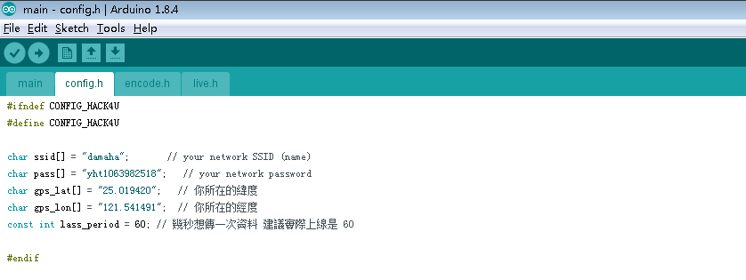
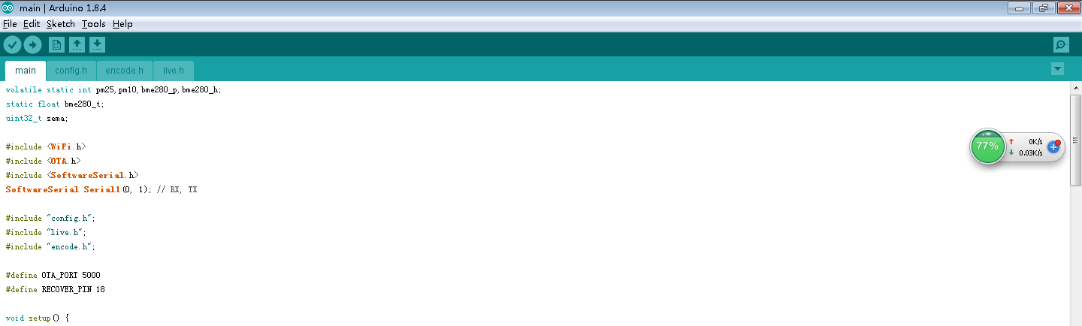
The progress of the sensor and what problem we are met
3. 上傳程式到 Ameba
3.1填寫經緯度、網路名稱與密碼
3.2上傳程式

Slide 15
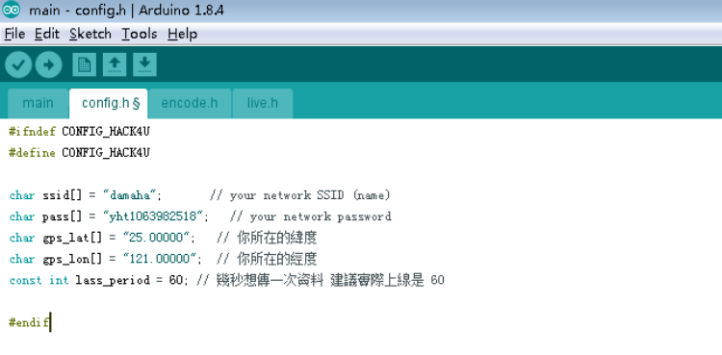
The progress of the sensor and what problem we are met
4. 設置正確的資料傳送頻帶、確保資料上鏈
4.1開啟 serial monitor 並選擇 baud rate 為 38400
4.2 得到UUID 后进入IOTA检索数据

Slide 16
The progress of the sensor and what problem we are met
Problem:
1. OTA.h 庫函數不存在
解答：
工具列要選對代碼的開發環境，我們這次使用的板子是AMEBA RTL8195A 如果不能夠選擇對的開發板環境，庫函數檔就不能夠變成加粗字體，此外，編譯就不能夠通過，就不能燒錄程式進開發板。

Slide 17
The progress of the sensor and what problem we are met
Problem: 2. 显示板的温度跟湿度没有数值
解答：
由于网站中及视频中的温度与湿度传感器跟我们自己的温度与湿度传感器虽然外形一样，但串口上还是存在差异，因此，不可只参考网站与视频中的外在连线为依据，来排线，连线，还是要根据对应的串口匹配文字接线。

Slide 18
The progress of the sensor and what problem we are met
Problem: 3. 有的時候會不顯示UUID:
解答:
由于每台空气盒子都会有独特的UUID，因此， 空气盒子在连上网络的时候并不一定都后显示UUID，重要的是要检查网路上是否有上链的数据信息，此外，如果空气盒子连接手机热点的话，一般情况是不会显示UUID。要想显示UUID的最好方法是将空气盒子连接WI-FI使用。

Slide 19
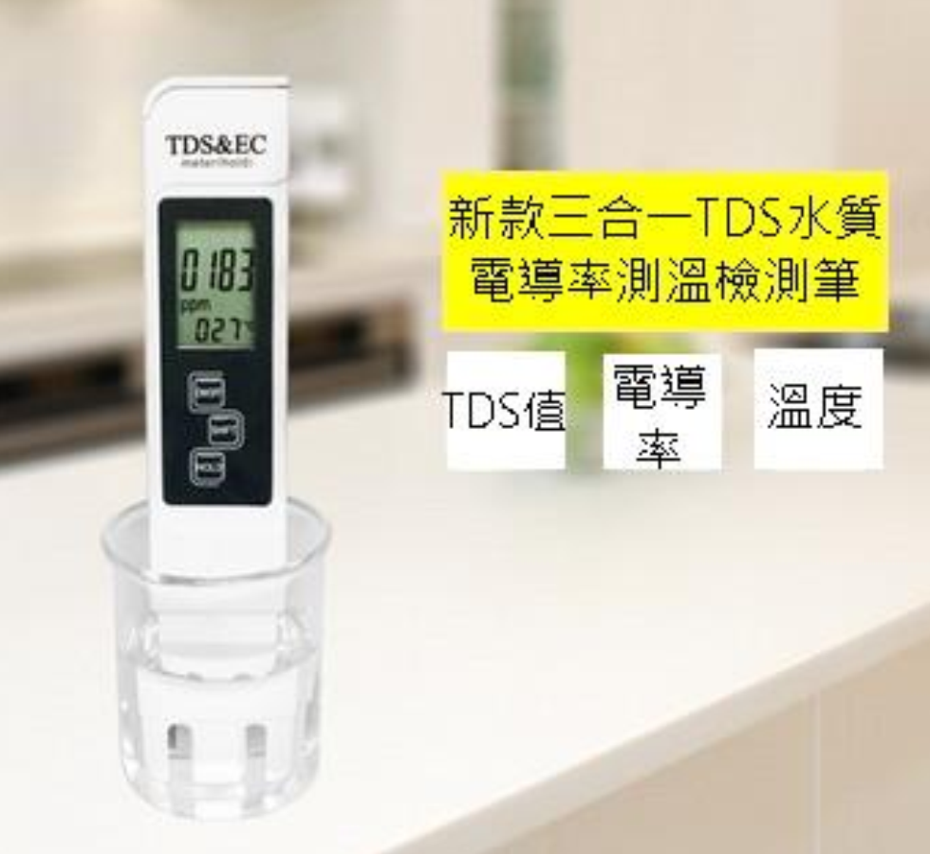
Additional Sensor(If Possible)
NEXT STAGE OF OUR PLAN
The sensor in our system is the Testing pen for water quality detection. As is shown in the picture below.
By measuring some basic physical quantities
We can measure the quality of water.

Slide 20
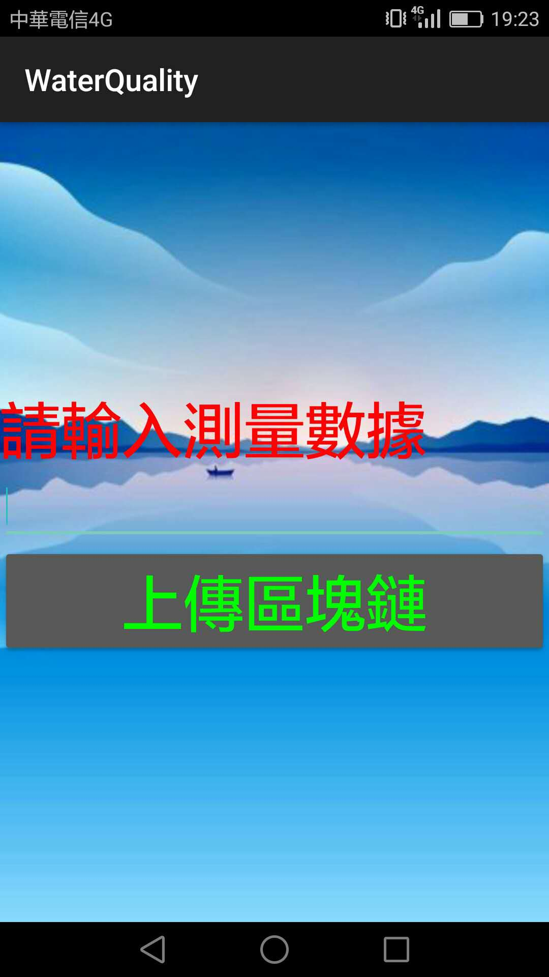
Upload data
We upload the data through
android app and everyone is
allowed to upload the data
into the block-chain.

Slide 21
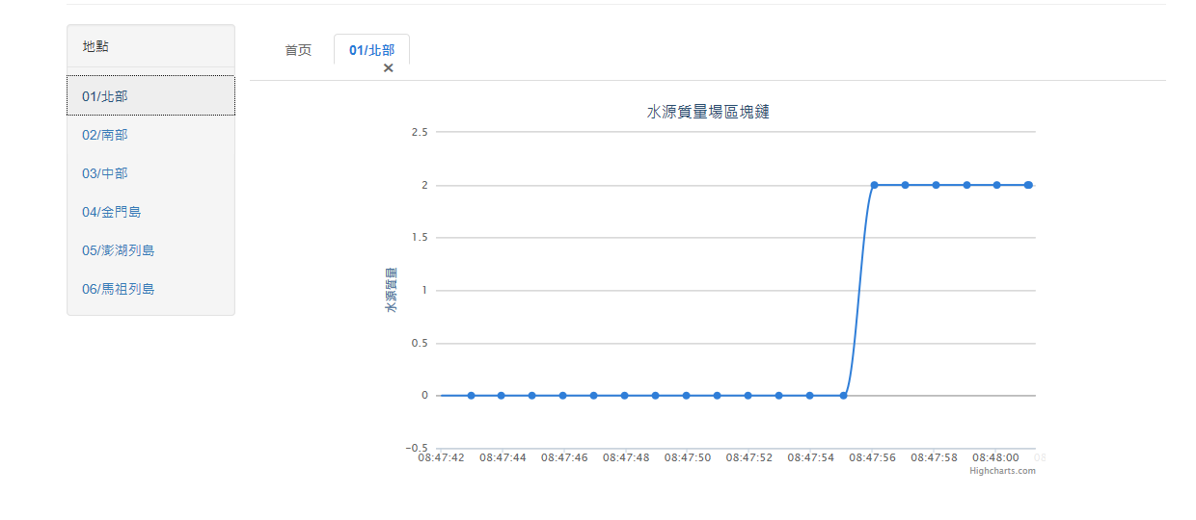
Sharing the data
After the data are uploaded, we can visit the website to get the data and the data are open to everyone.

Slide 22
The consensus between the data
The data is stored in the block-chain system, which is distributed to every node of the system.
The node can get consensus through voting.

Slide 23
Demo
The data can be visited through URL http://149.28.40.229/pro
The data can be uploaded through android apps.

Slide 24
Thanks for your listening！ ---group10

